Slide 1
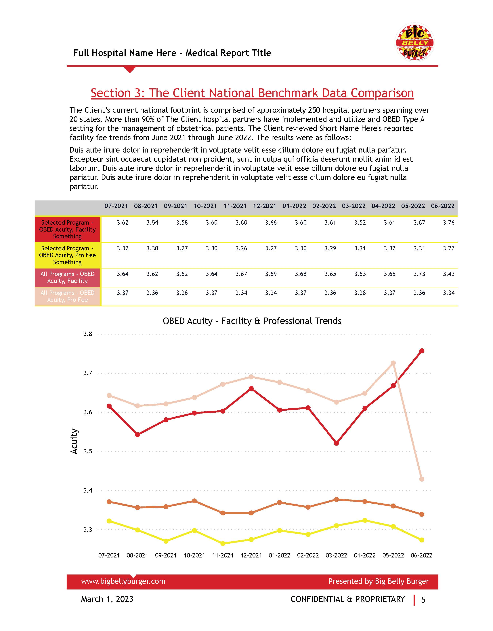




Extract: Excel File in Sharepoint
Load: Power BI
Transform: Power Query
Build Report
Publish App in Power BI Service
Automated Medical Financial Reporting

Slide 2
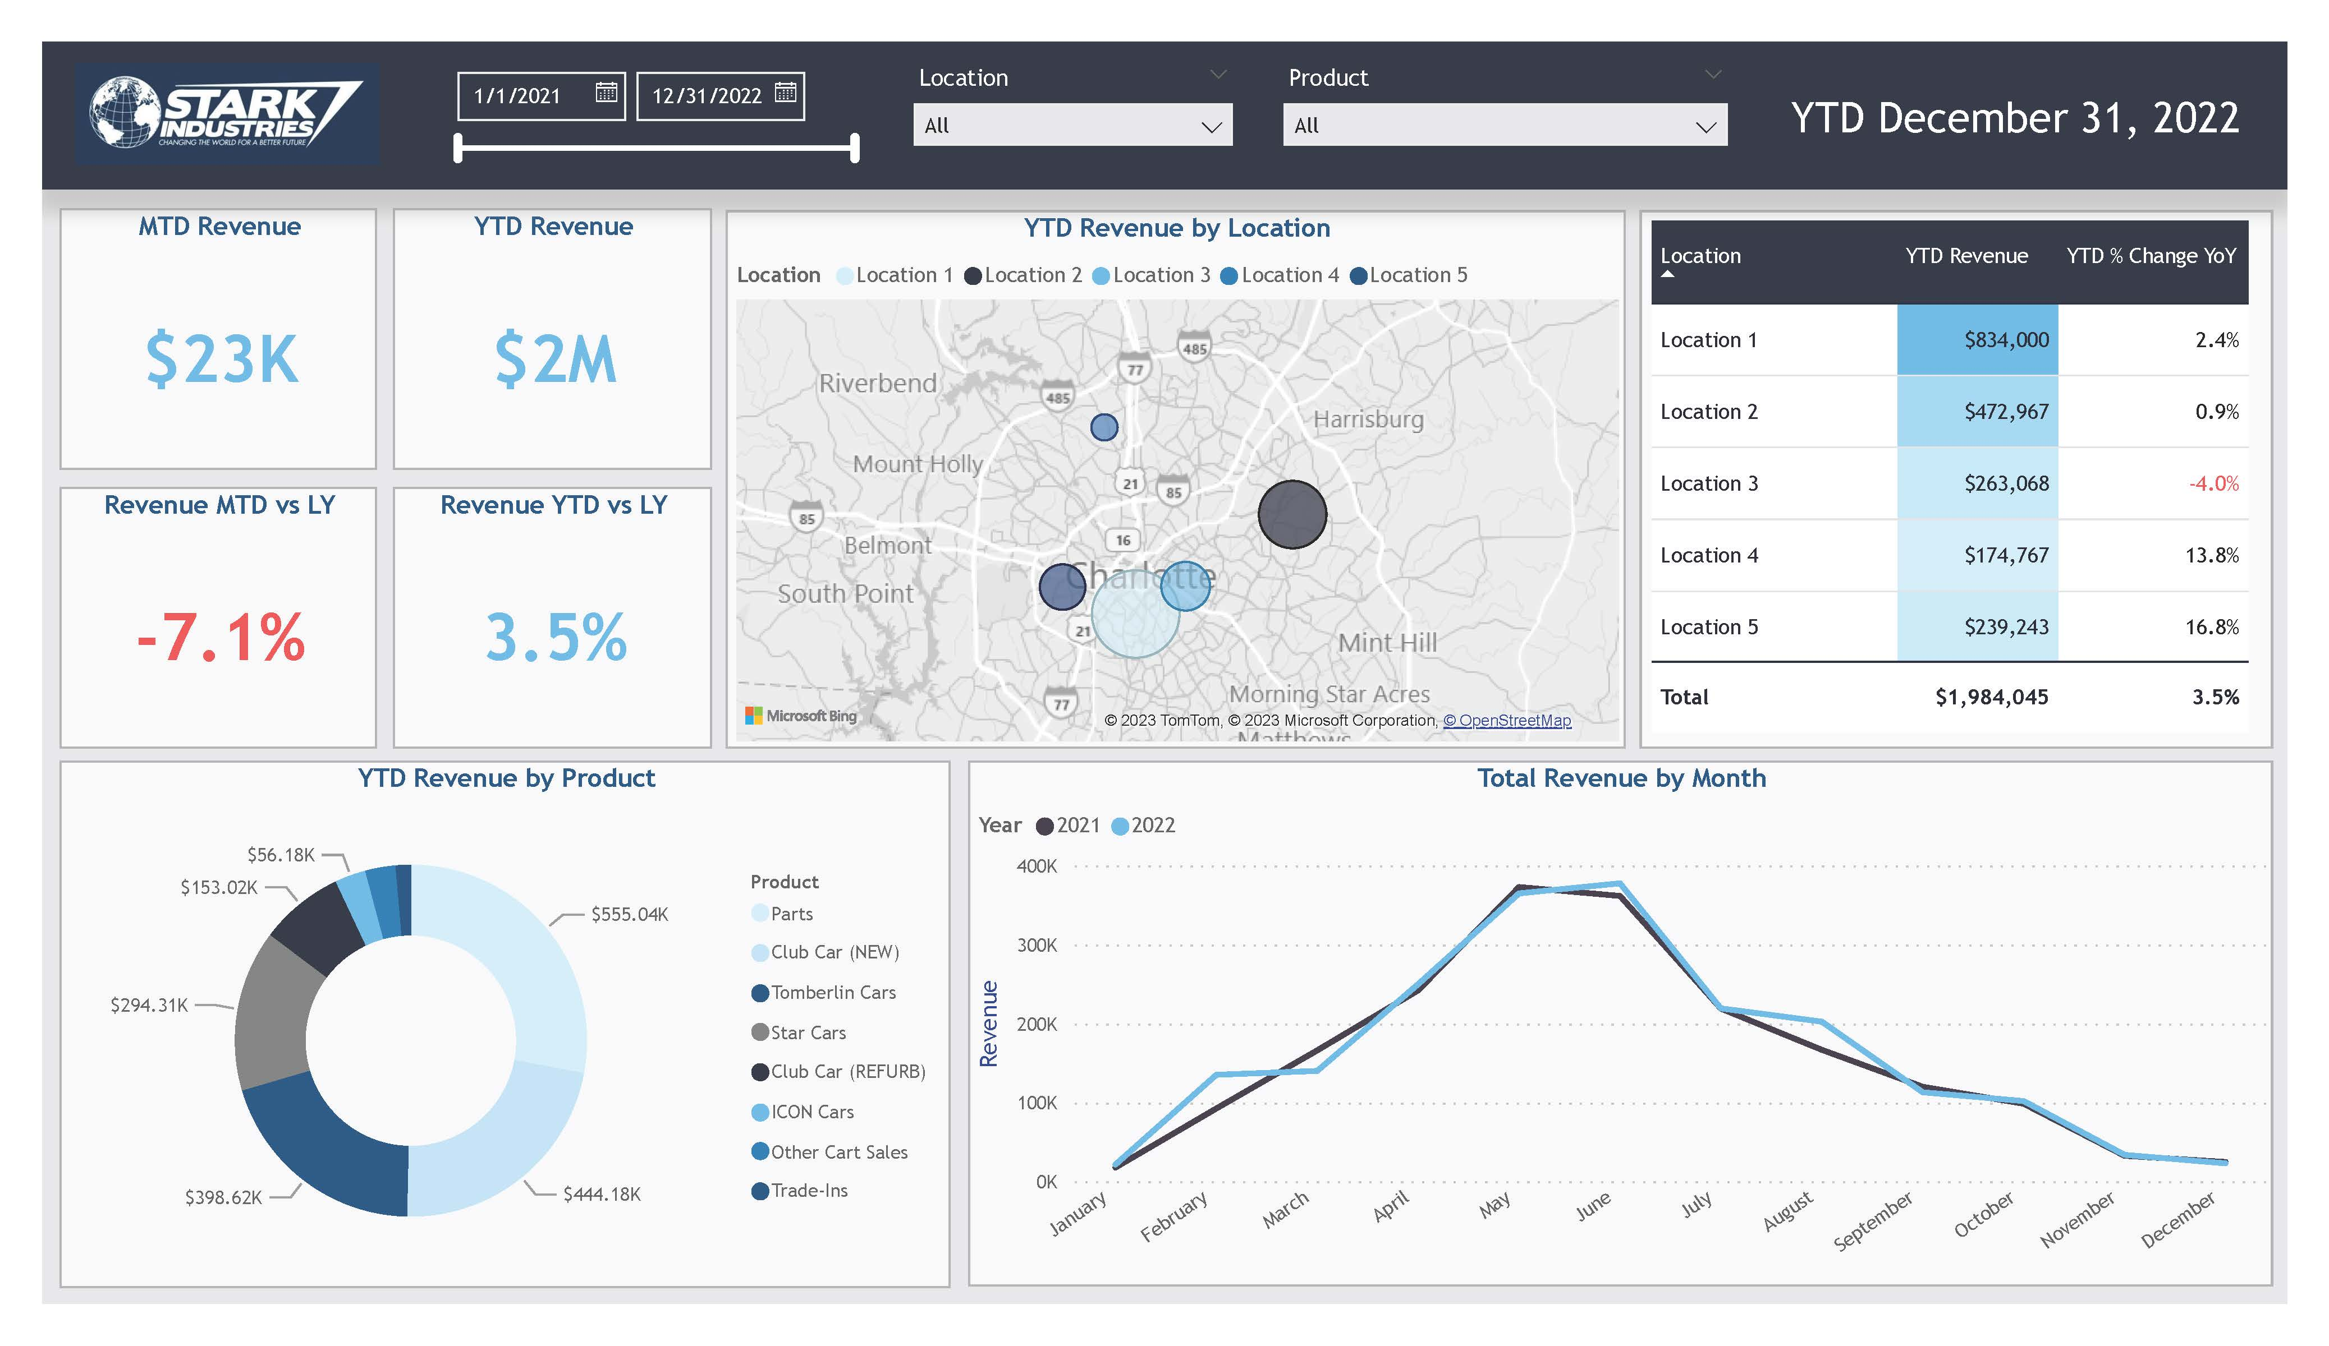
Extract: Excel File in Sharepoint
Load: Power BI
Transform: Power Query
Build Report
Publish App in Power BI Service
Client Proposal Dashboard

Slide 3
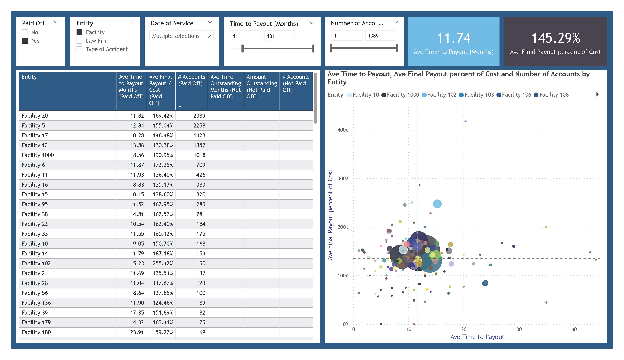
Extract: Excel File in Sharepoint
Load: Power BI
Transform: Power Query
Build Report
Publish App in Power BI Service
Current Client Analytics Demo

Slide 4
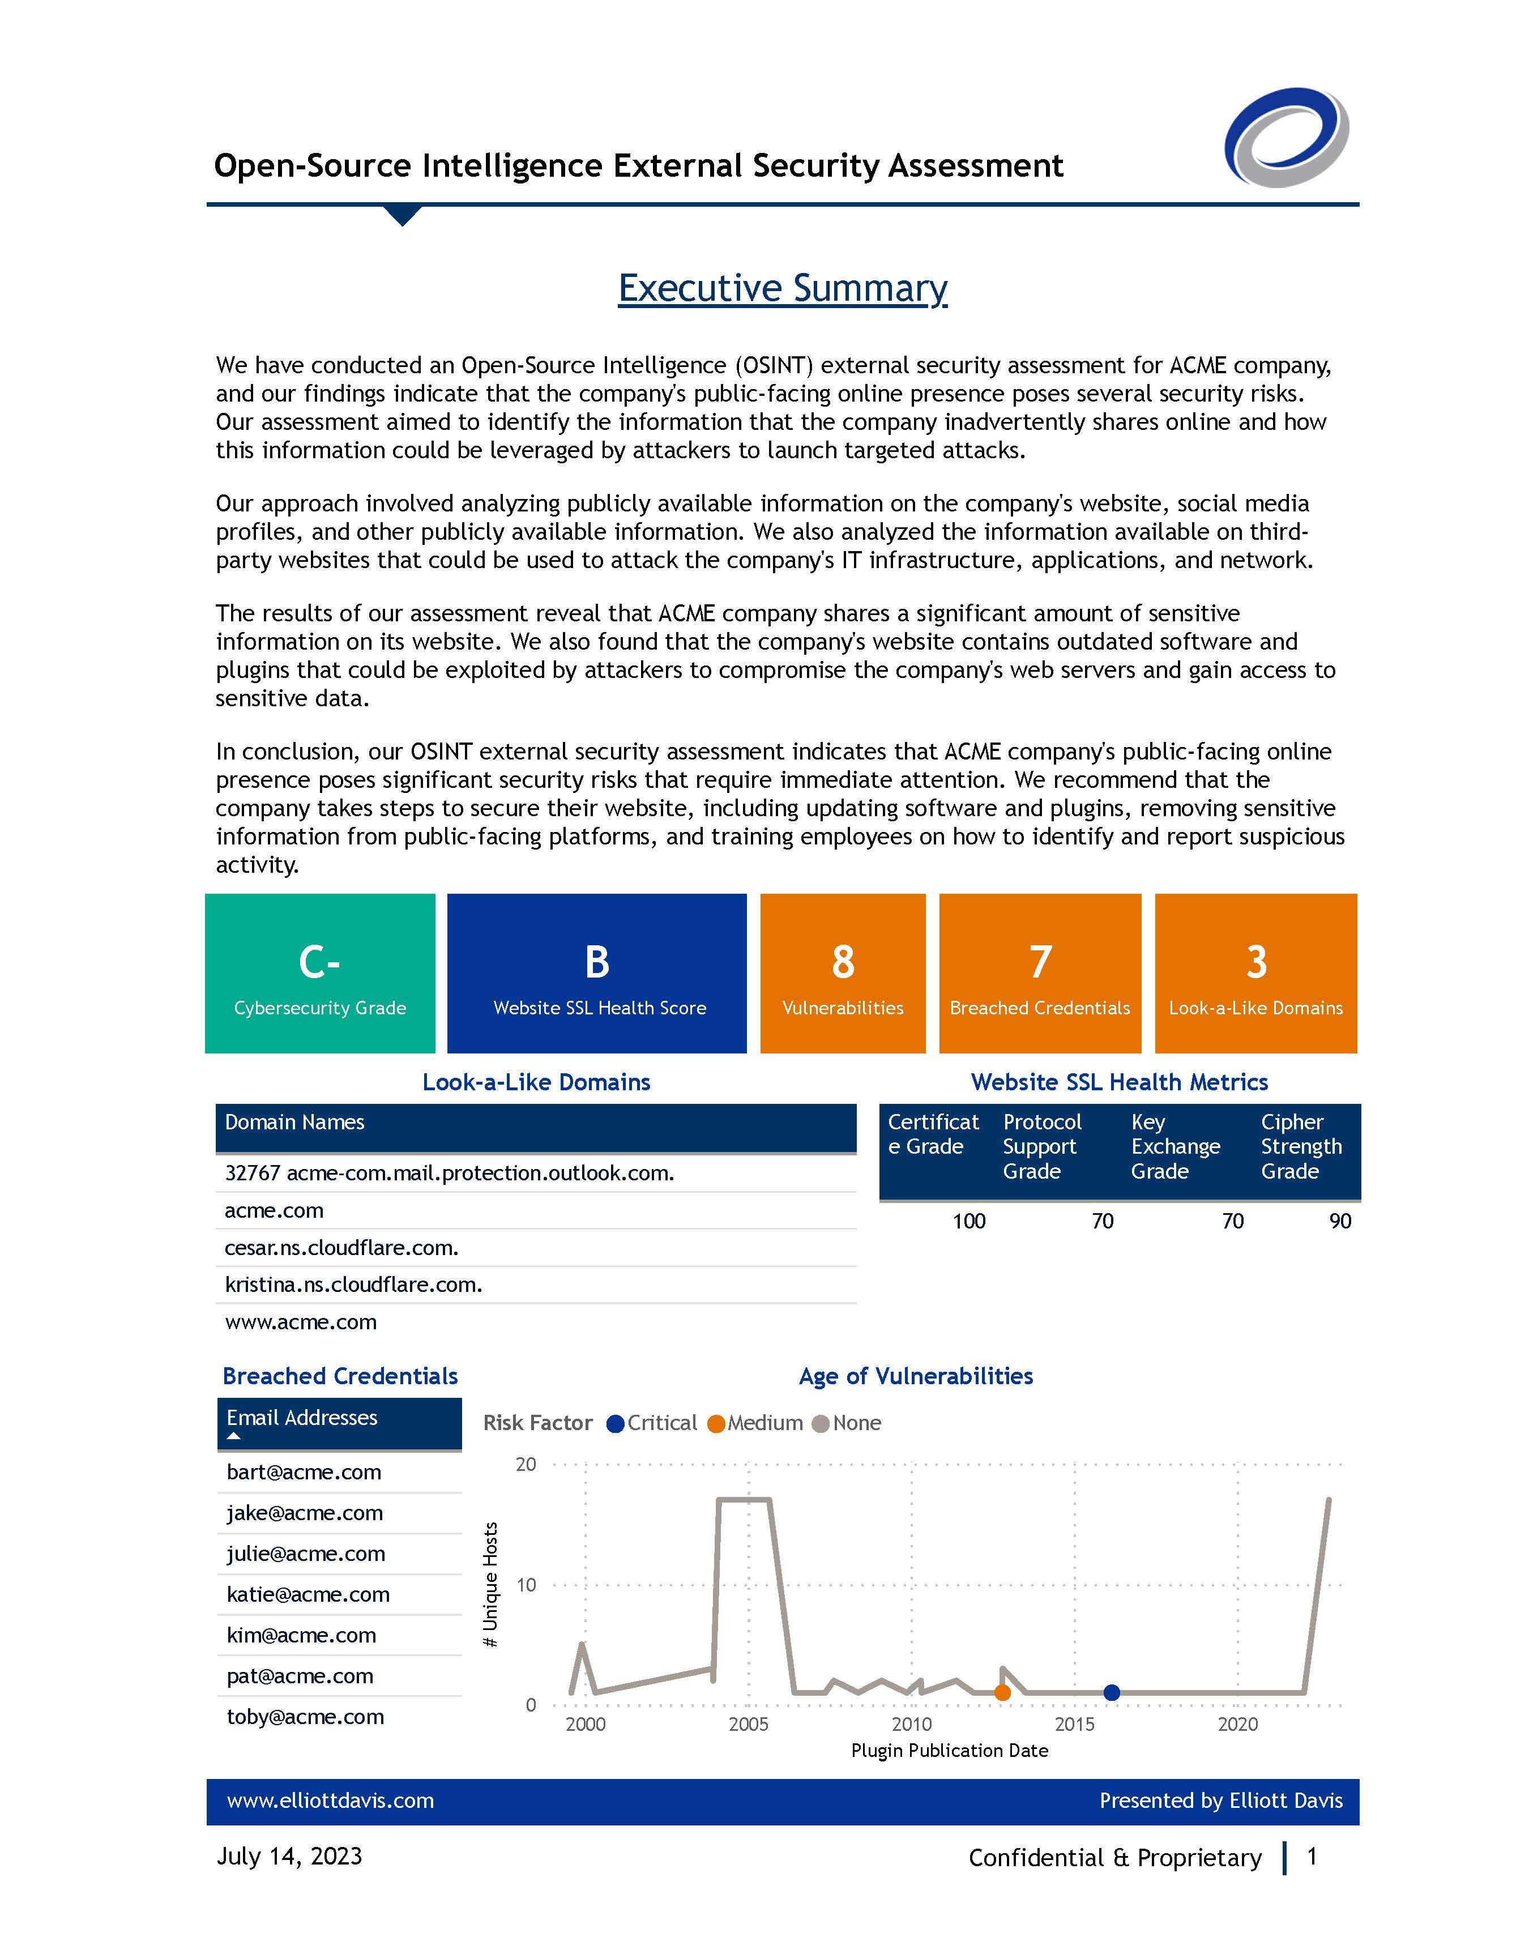
Extract: Excel File in Sharepoint
Load: Power BI
Transform: Power Query
Build Report
Cybersecurity Analytics Report

Slide 5
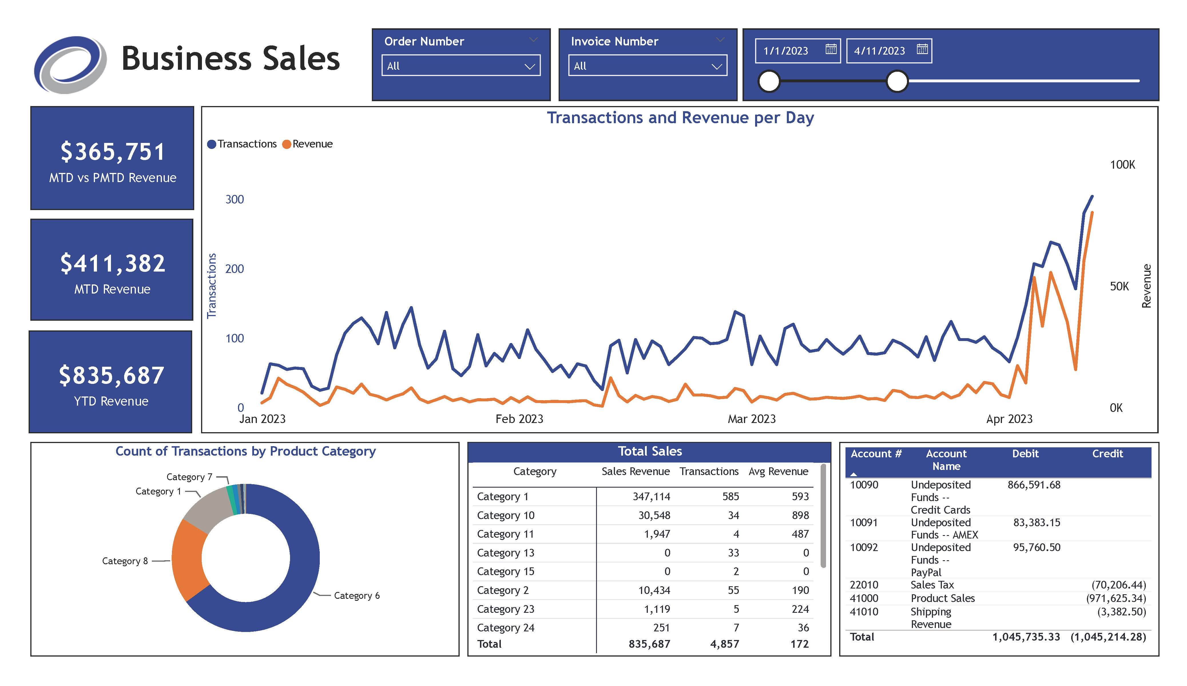

Extract: AWS S3
Load: Power BI
Transform: Power Query
Build Report
Publish App in Power BI Service
External Webinar Dashboards

Slide 6
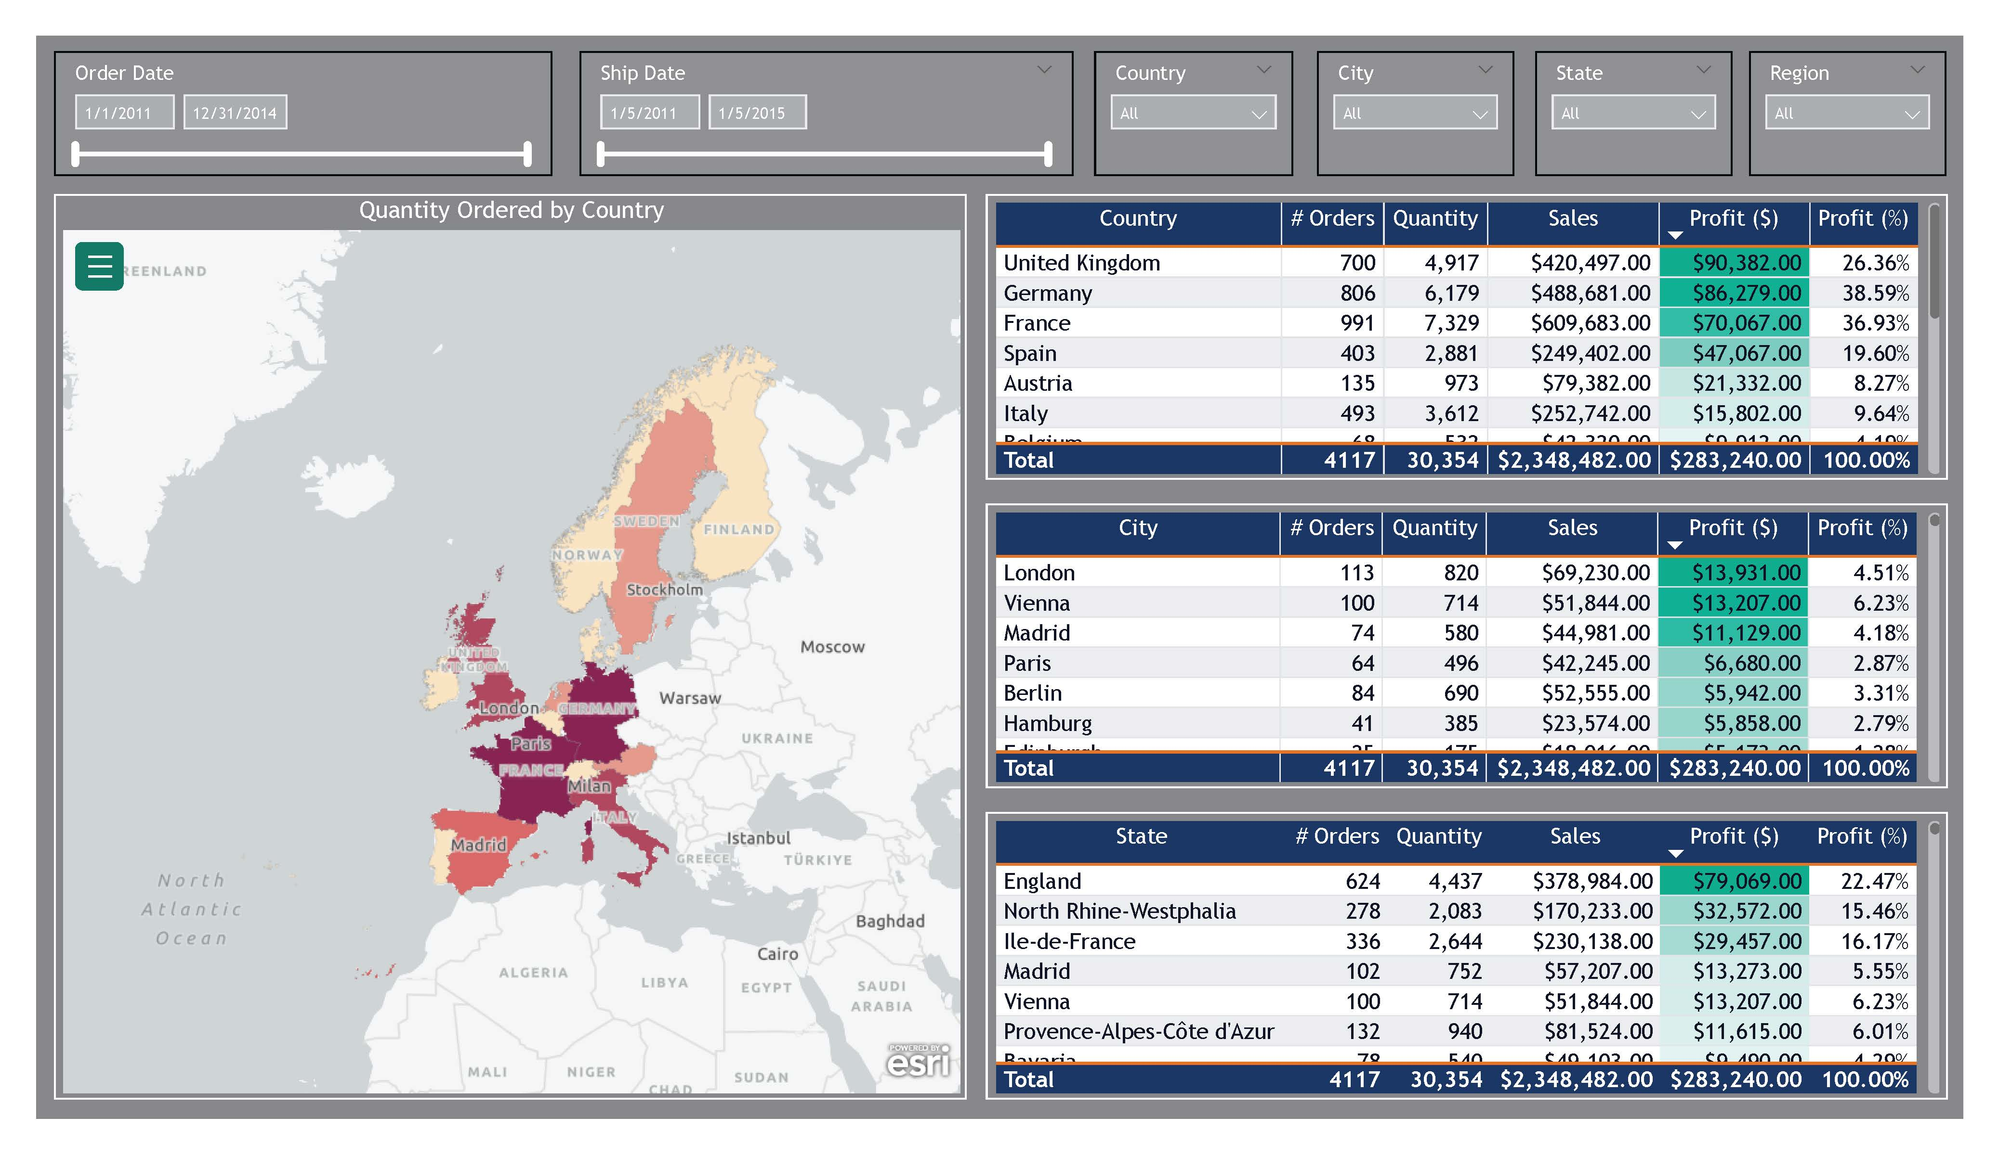
Extract: Excel File in Sharepoint
Load: Power BI
Transform: Power Query
Build Report
Publish App in Power BI Service
Group Case Study Demo

Slide 7
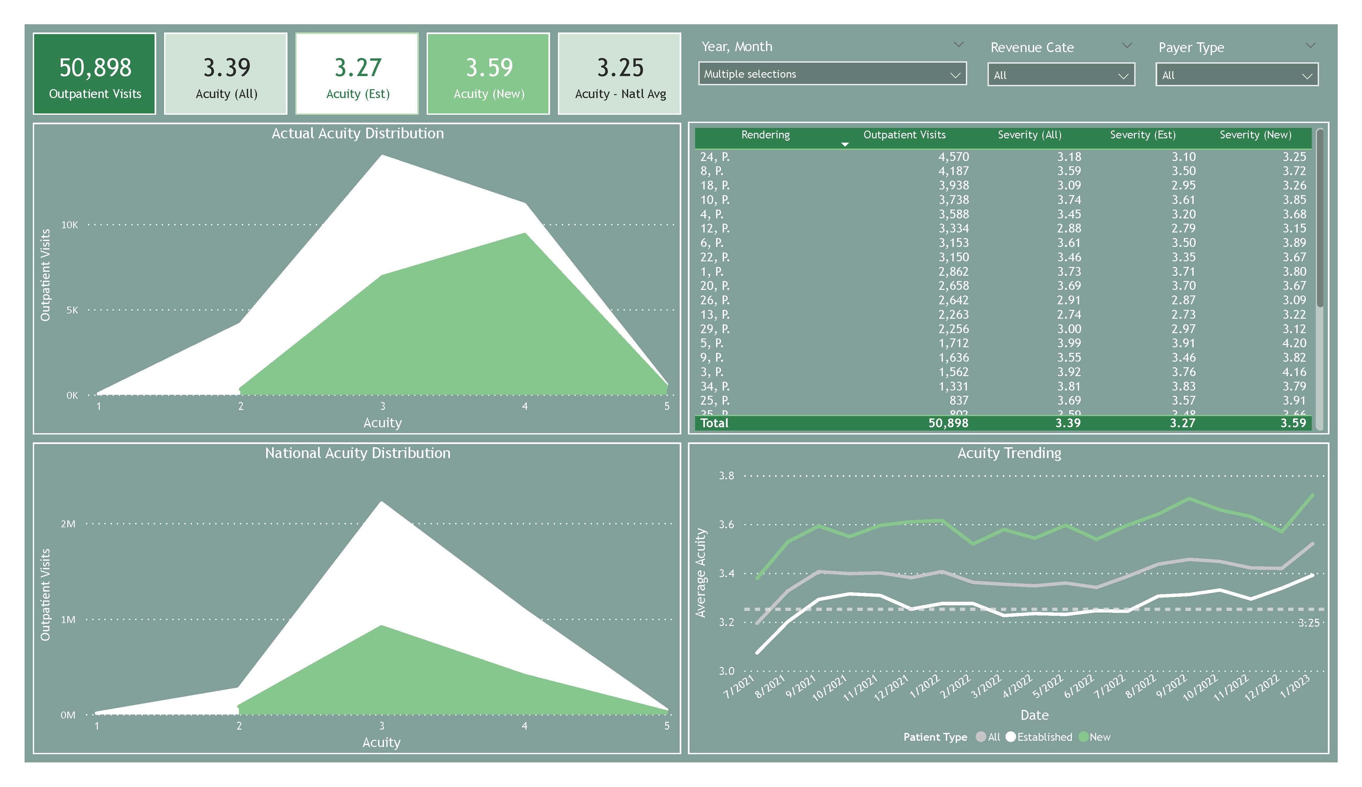
Extract: Excel File in Sharepoint
Load: Power BI
Transform: Power Query
Build Report
Publish App in Power BI Service
Healthcare Ongoing Dashboard

Slide 8
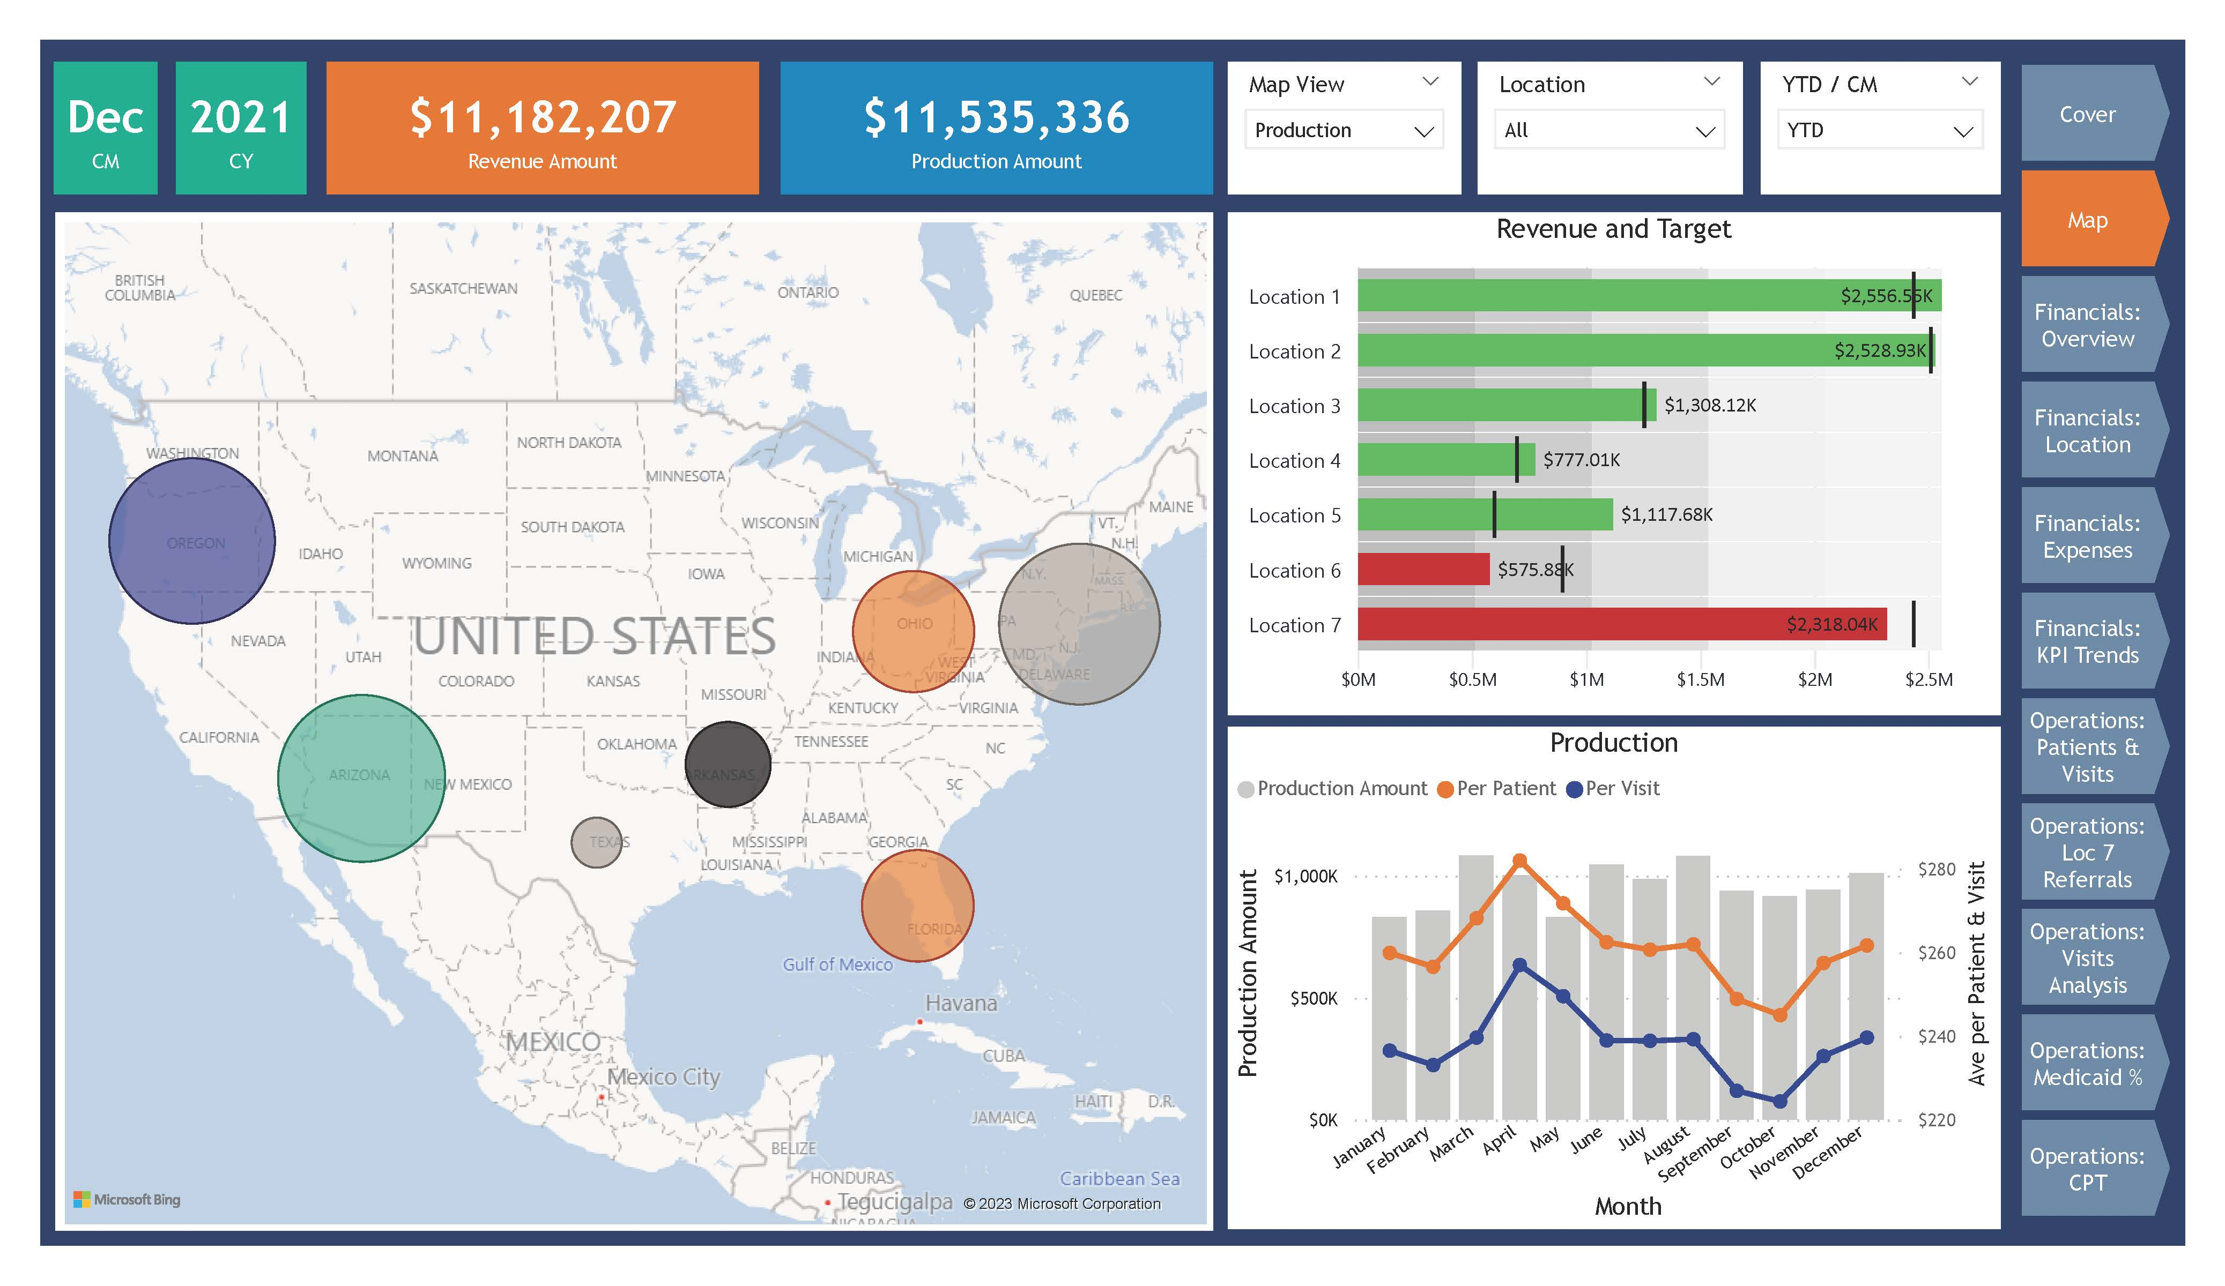
Extract: Excel File in Sharepoint
Load: Power BI
Transform: Power Query
Build Report
Healthcare Private Practice

Slide 9
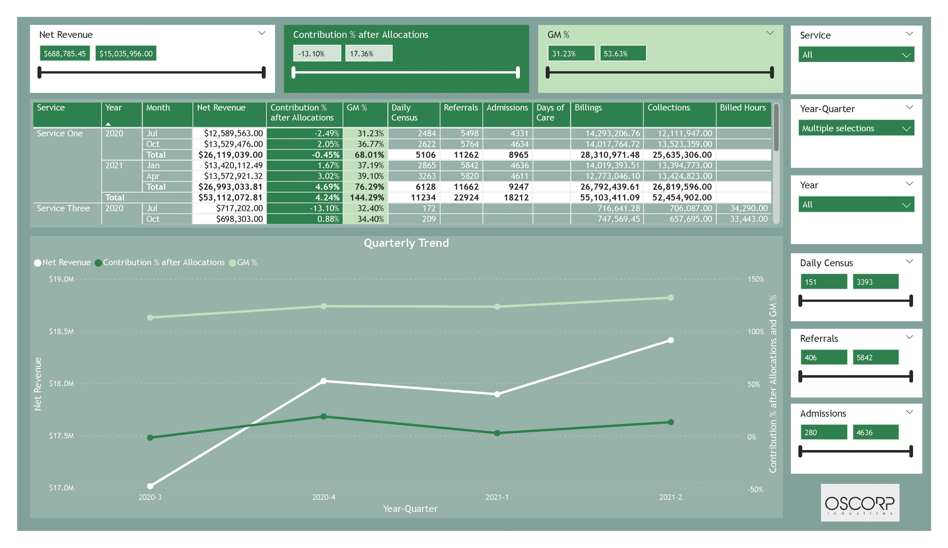
Extract: Excel File in Sharepoint
Load: Power BI
Transform: Power Query
Build Report
Healthcare Proposal Dashboard

Slide 10
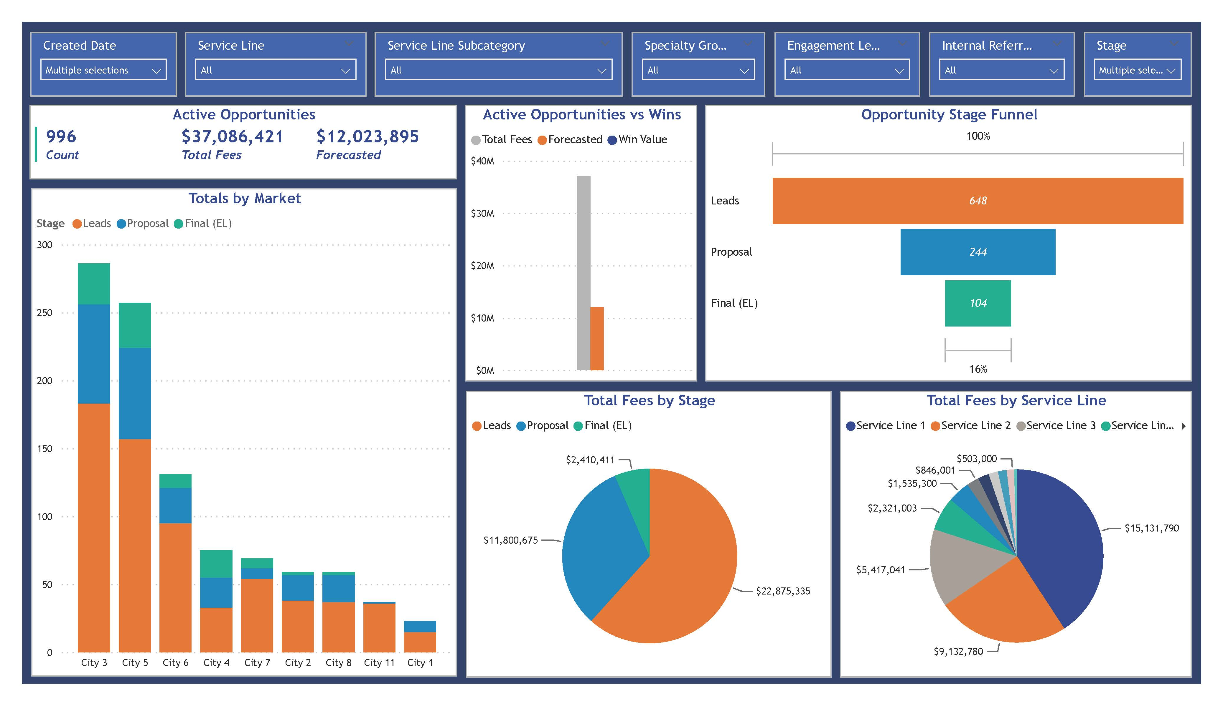

Extract: Smartsheet
Load: Power BI
Transform: Power Query
Build Report
Publish App in Power BI Service
Internal Use Work Tracker

Slide 11
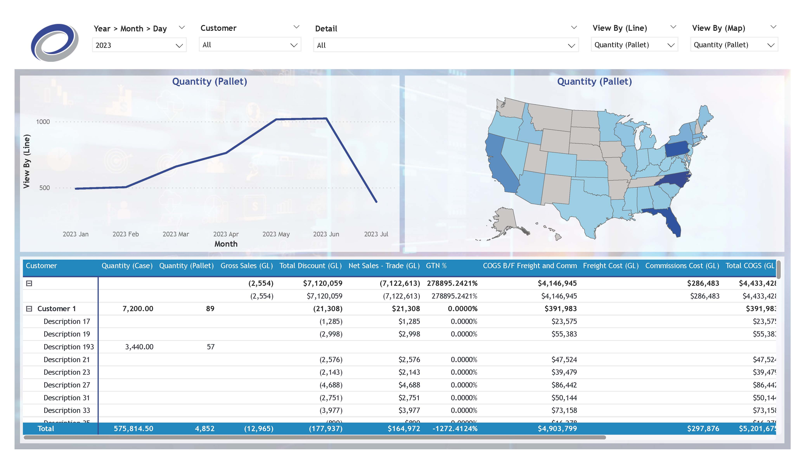

Extract: SQL Database
Load: Power BI
Transform: Power Query
Build Report
Publish App in Power BI Service
Manufacturing Client Demo

Slide 12
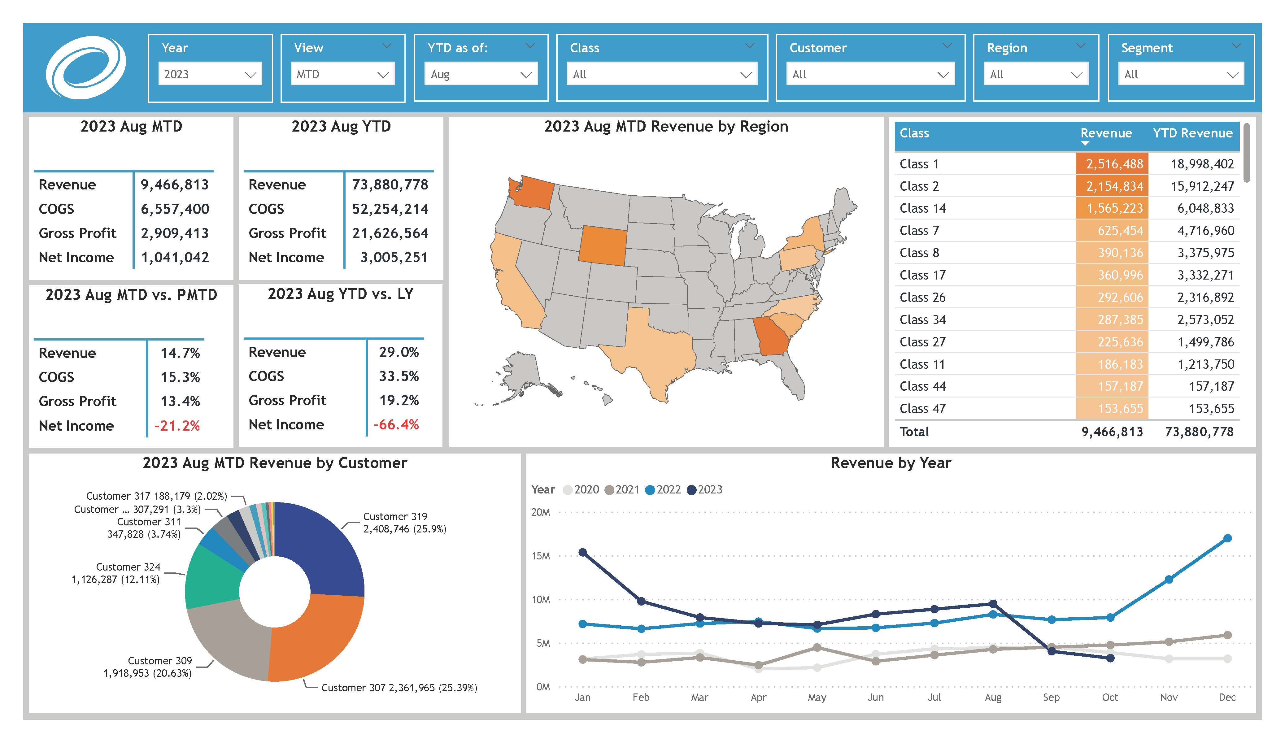

Extract: QuickBooks Online
Load: Power BI
Transform: Power Query
Build Report
Publish App in Power BI Service
Manufacturing QuickBooks Analysis

Slide 13
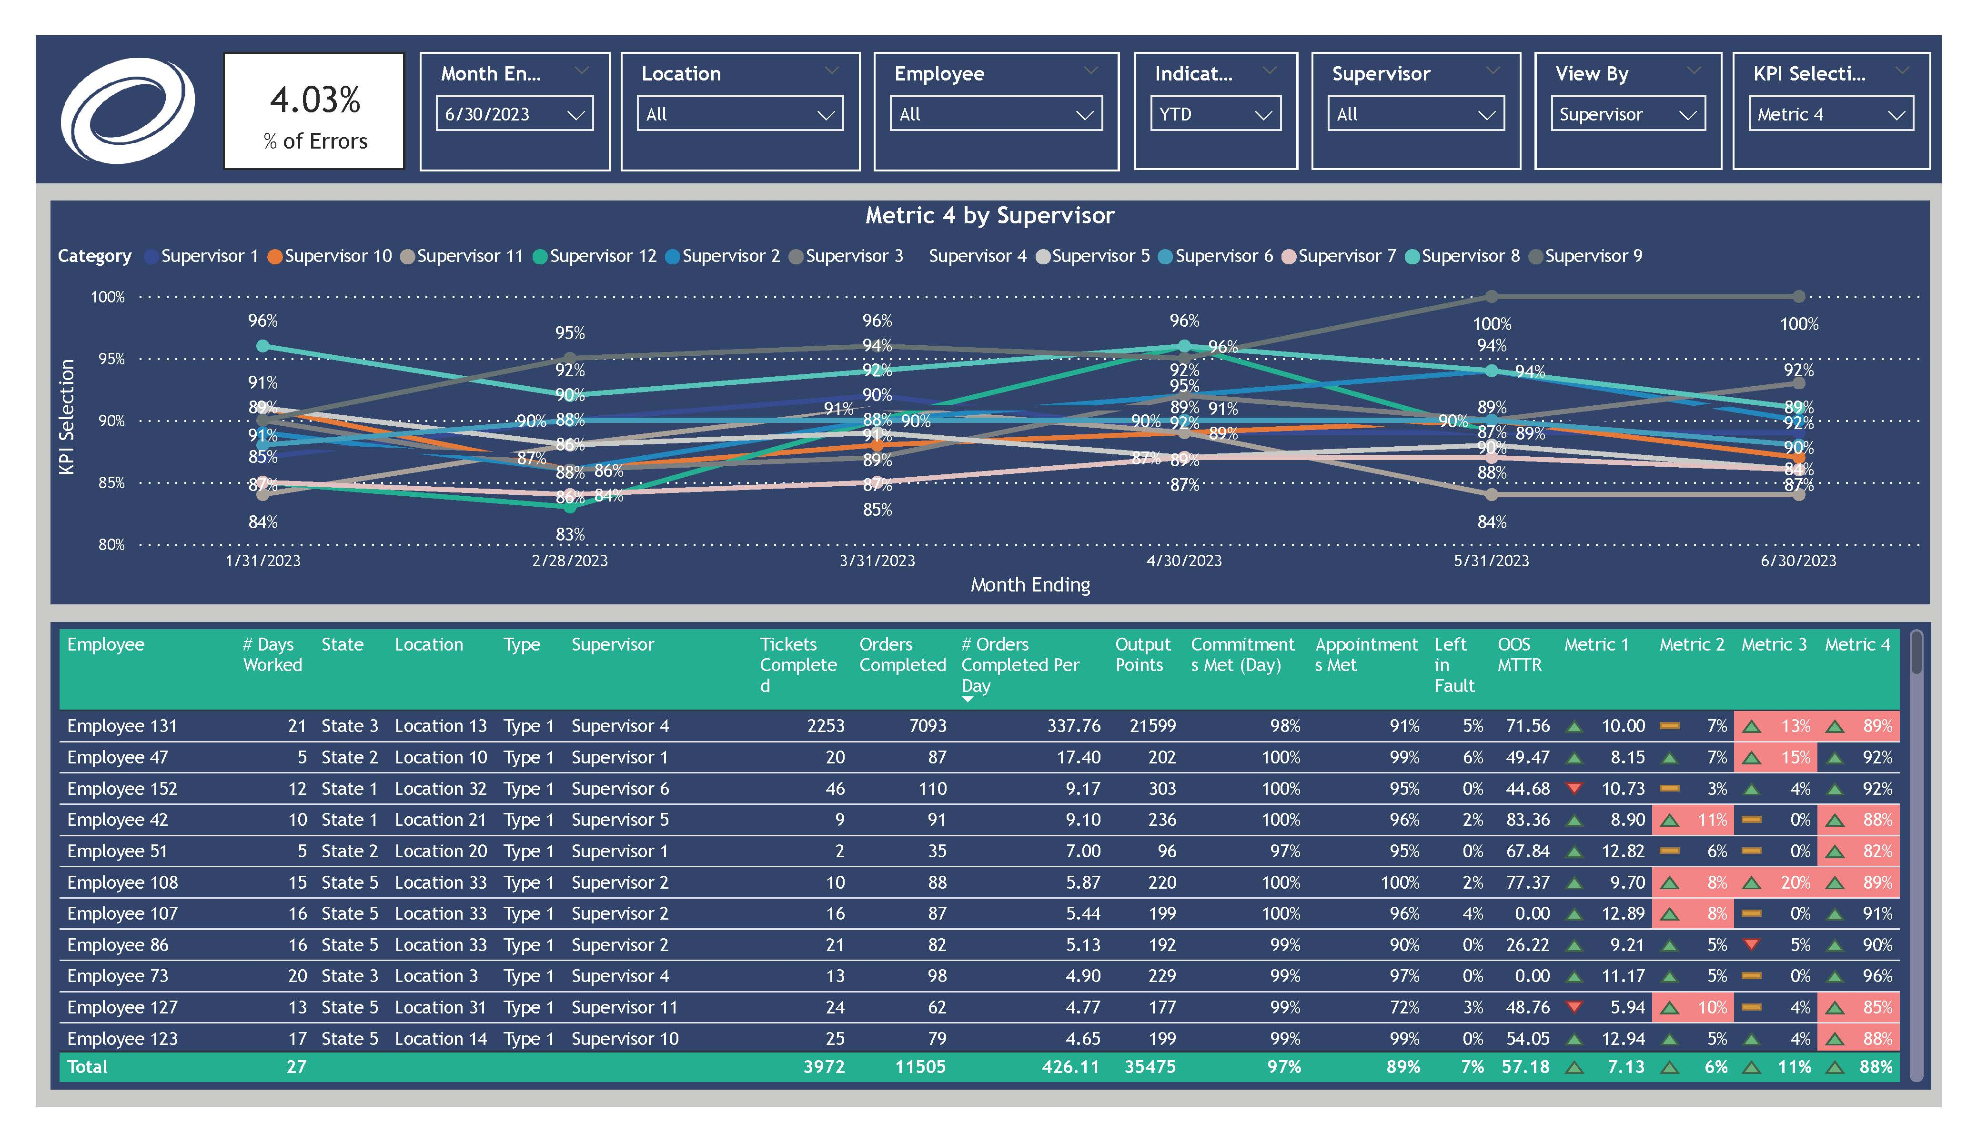
Extract: Excel File in Sharepoint
Load: Power BI
Transform: Power Query
Build Report
Publish App in Power BI Service
Manufacturing Supervisor Dashboards

Slide 14
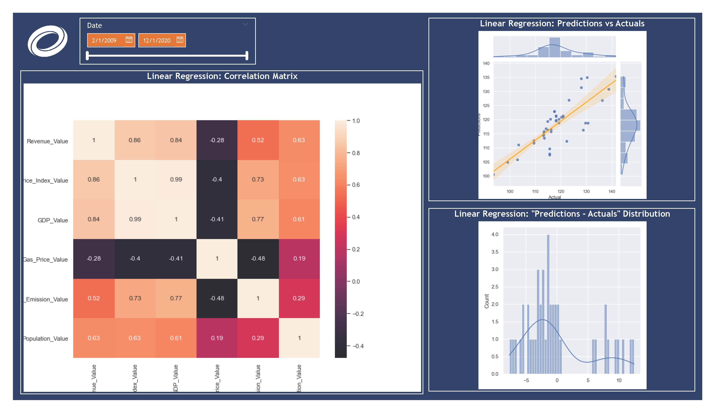

Extract: APIs and Web Scraping with Python
Load: Power BI
Transform: Power Query
Build Report
Extract: Excel File
Power BI + Python + Machine Learning Forecasting

Slide 15
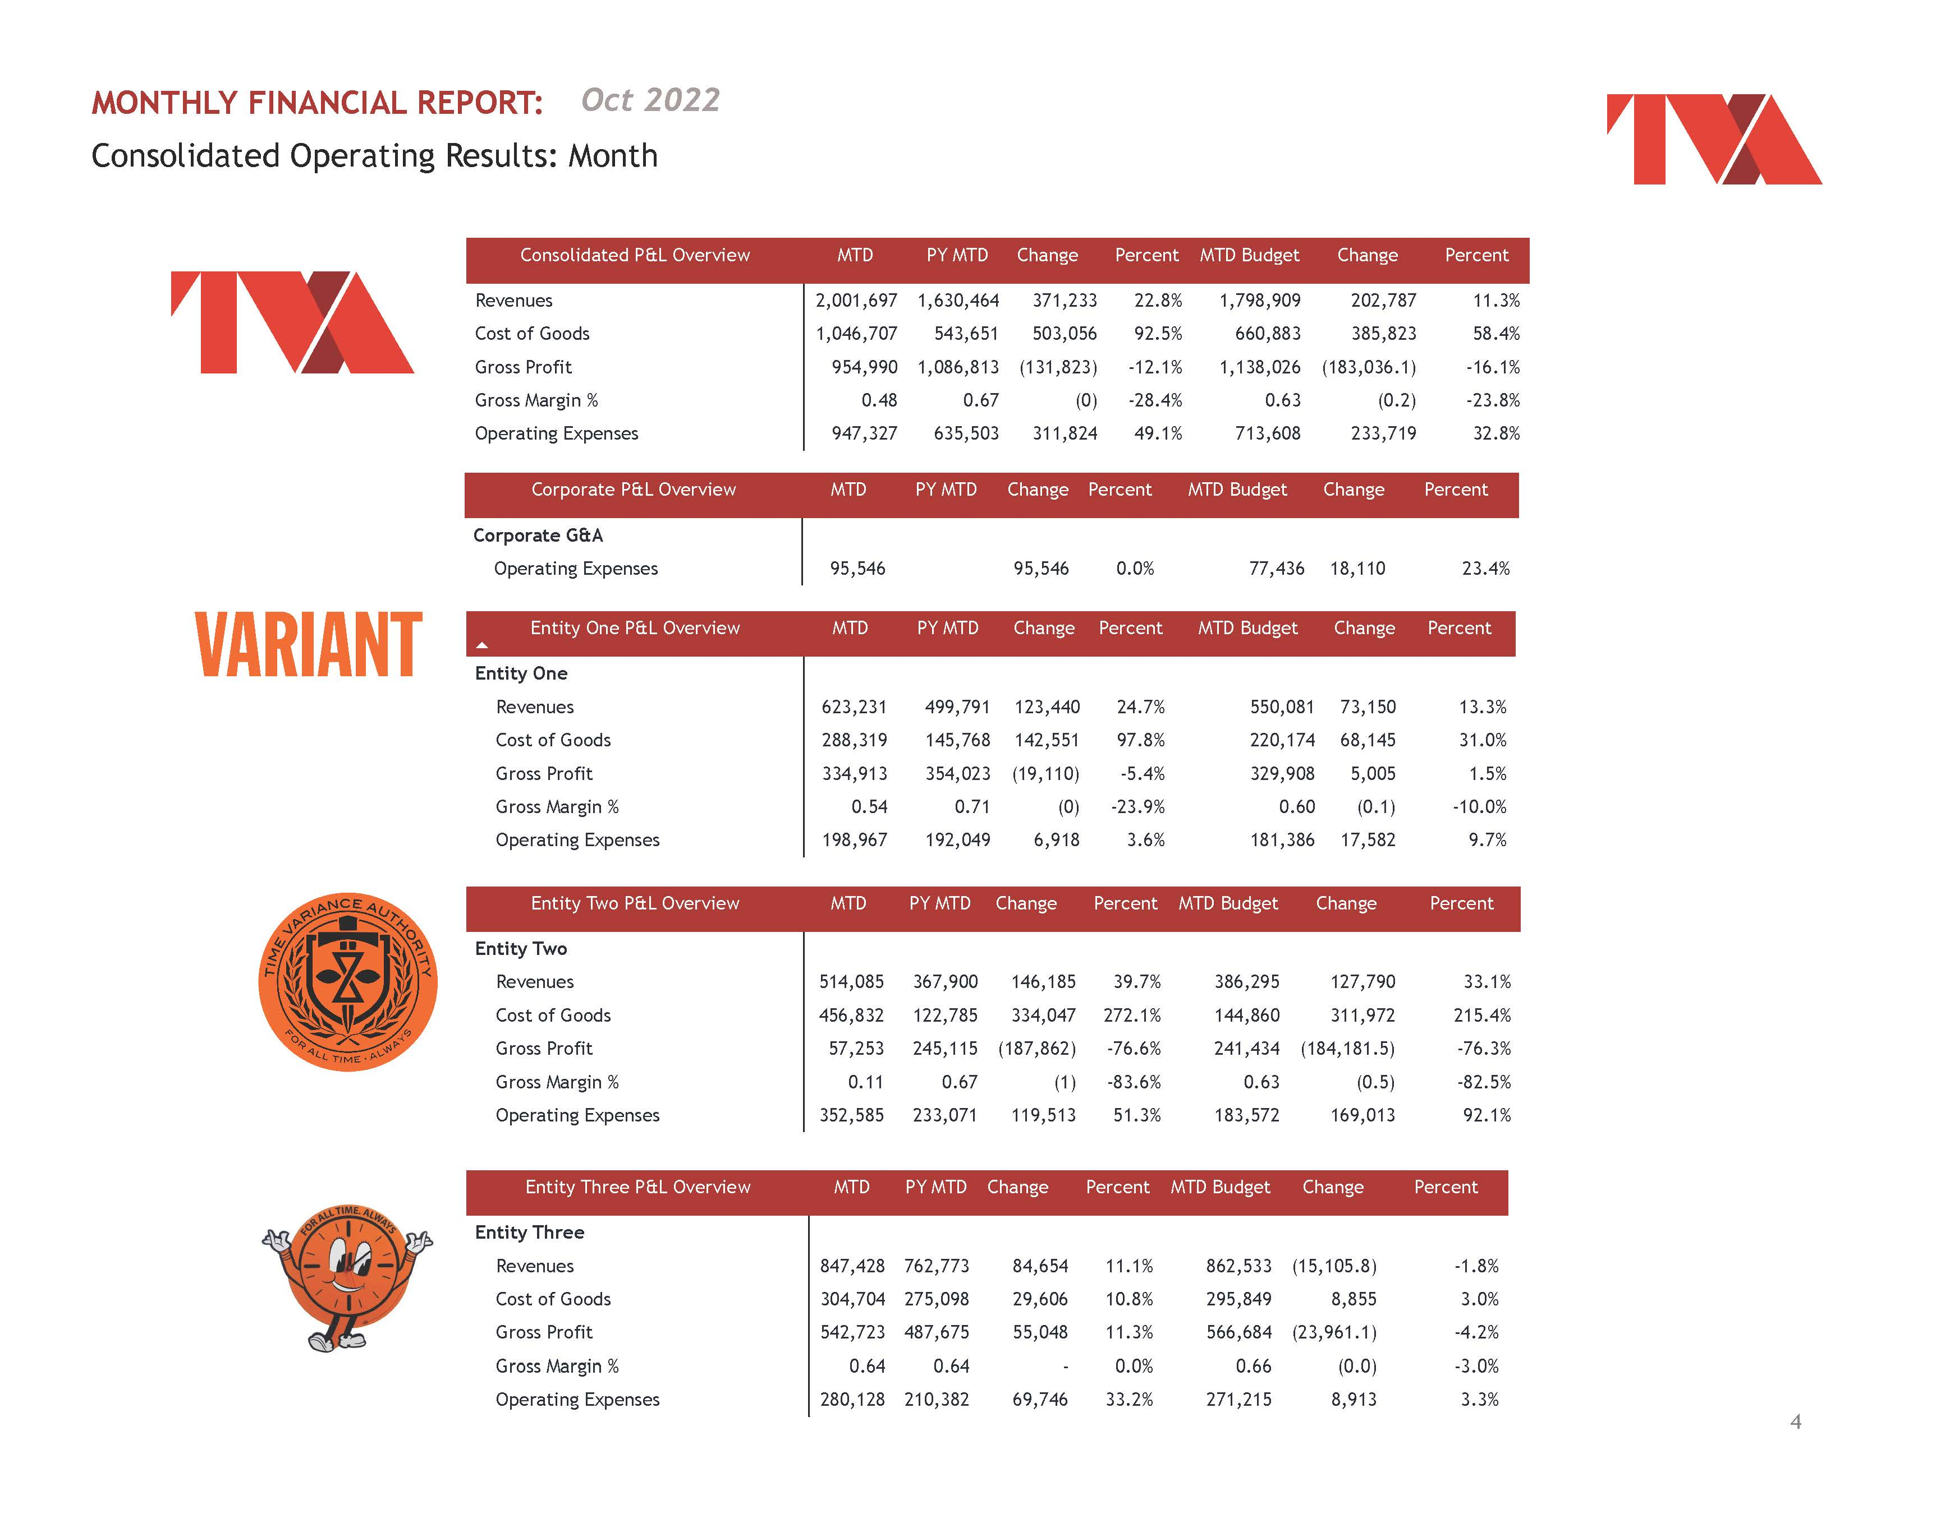
Extract: Excel File in Sharepoint
Load: Power BI
Transform: Power Query
Build Report
Private Equity Financial Reporting Automation

Slide 16
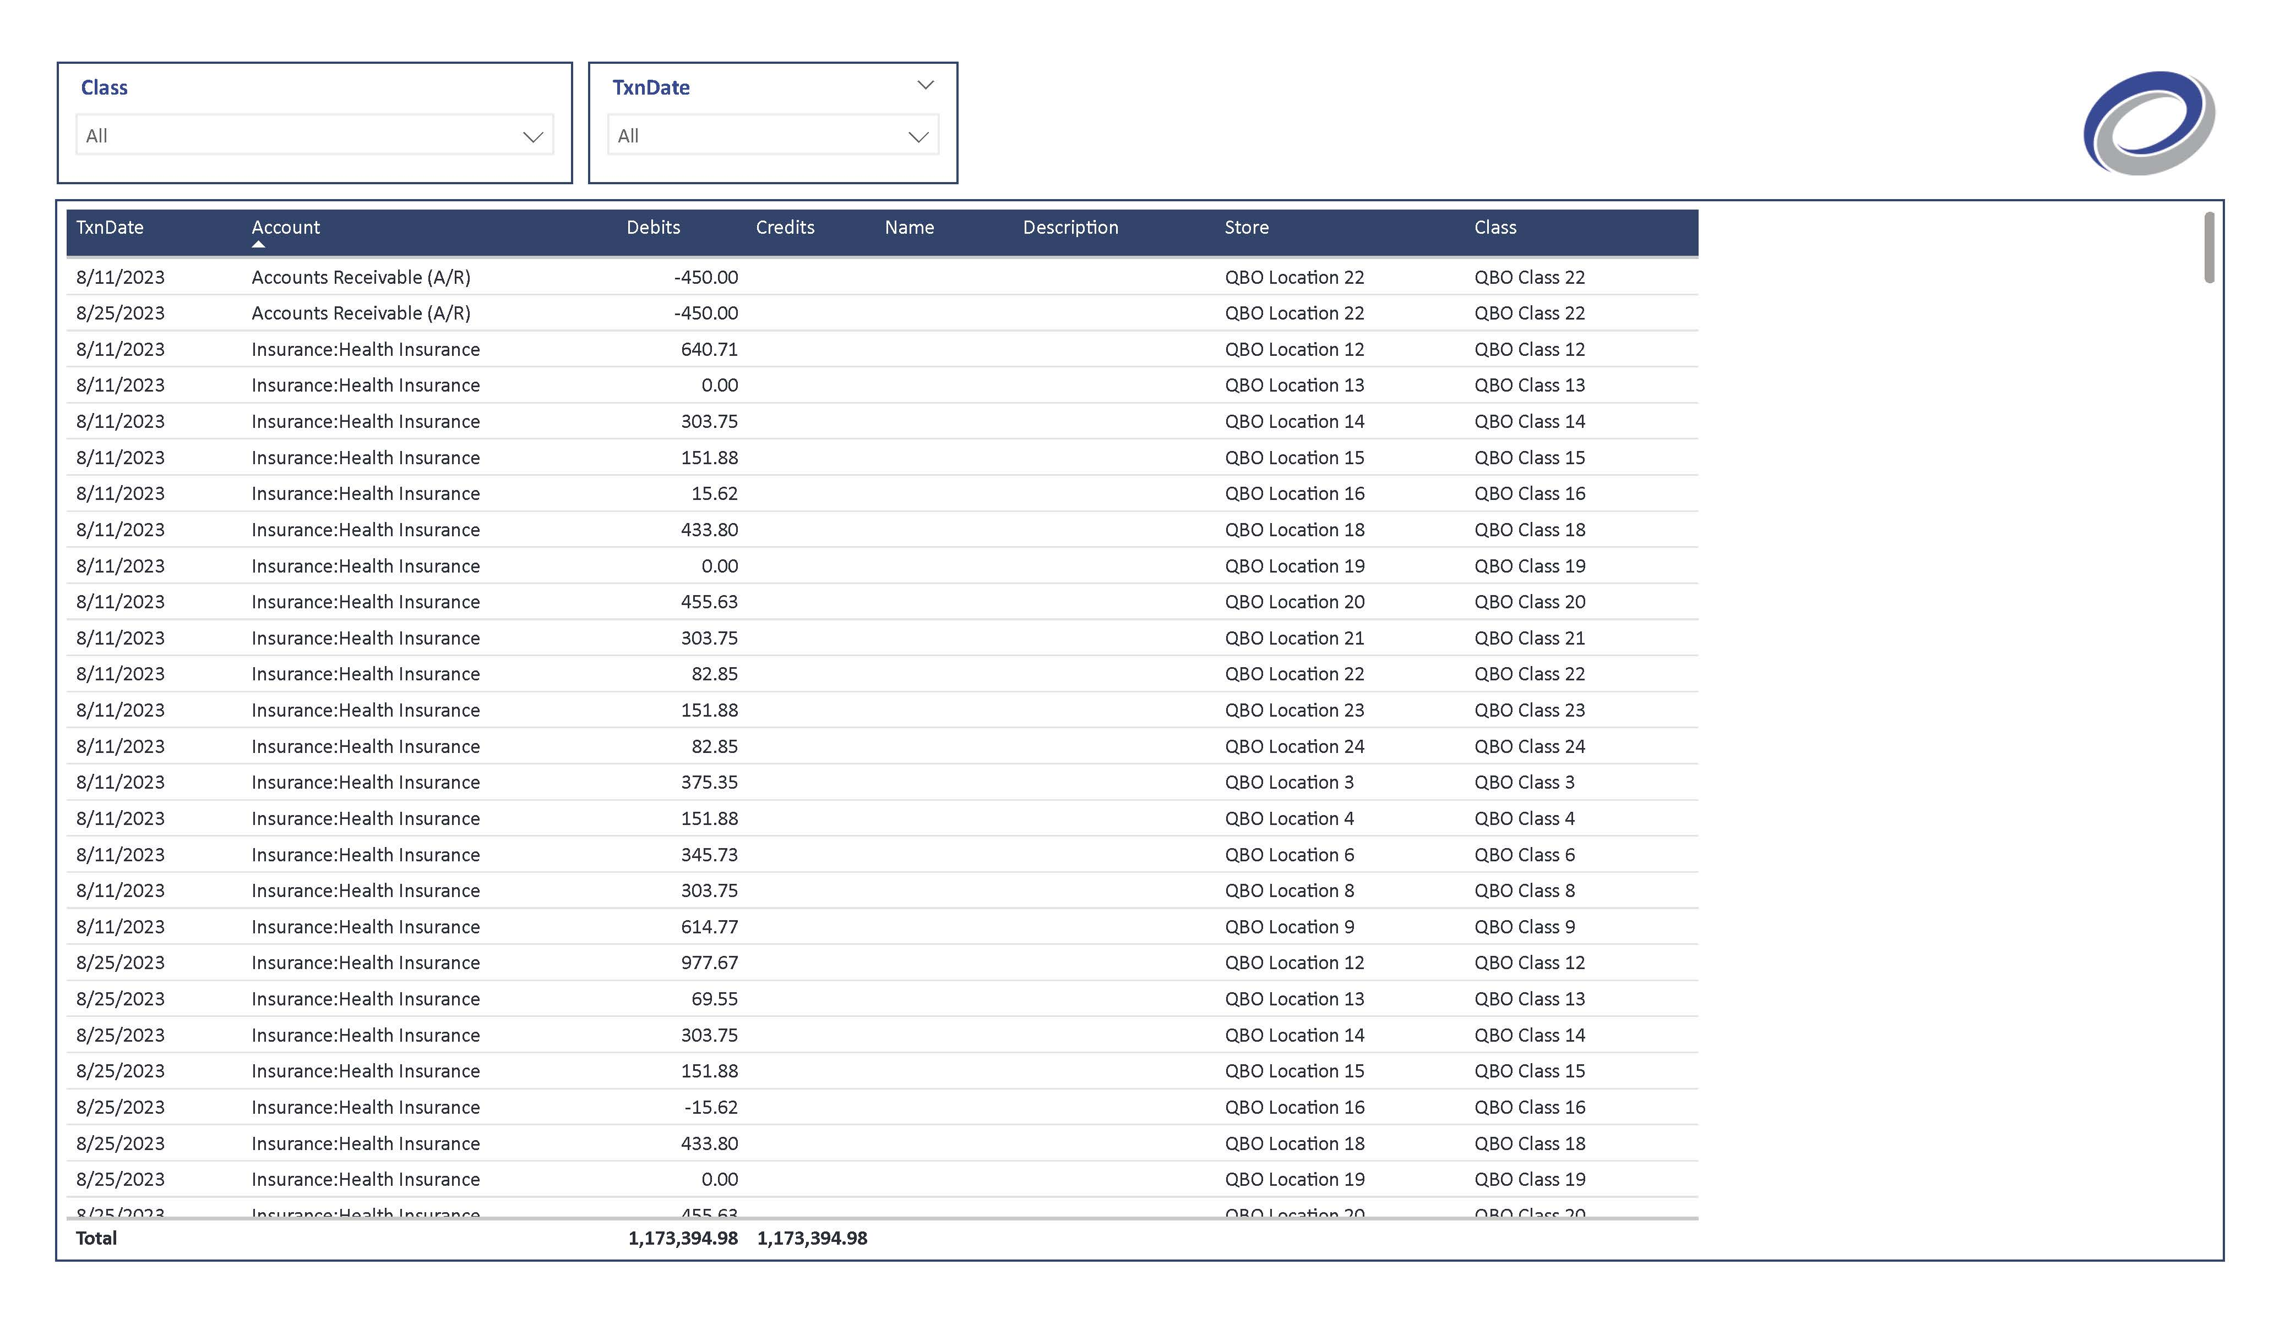
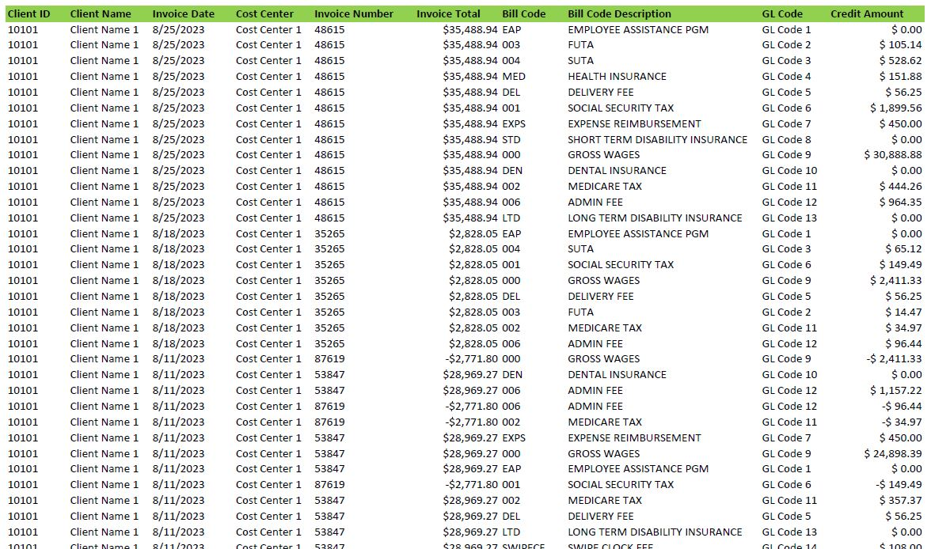
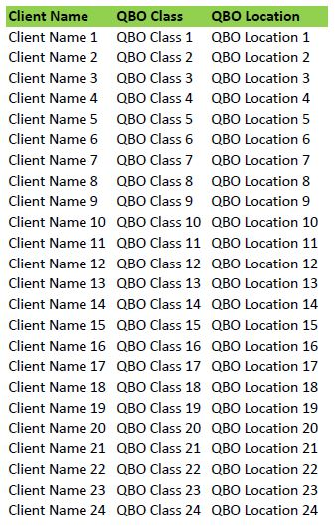
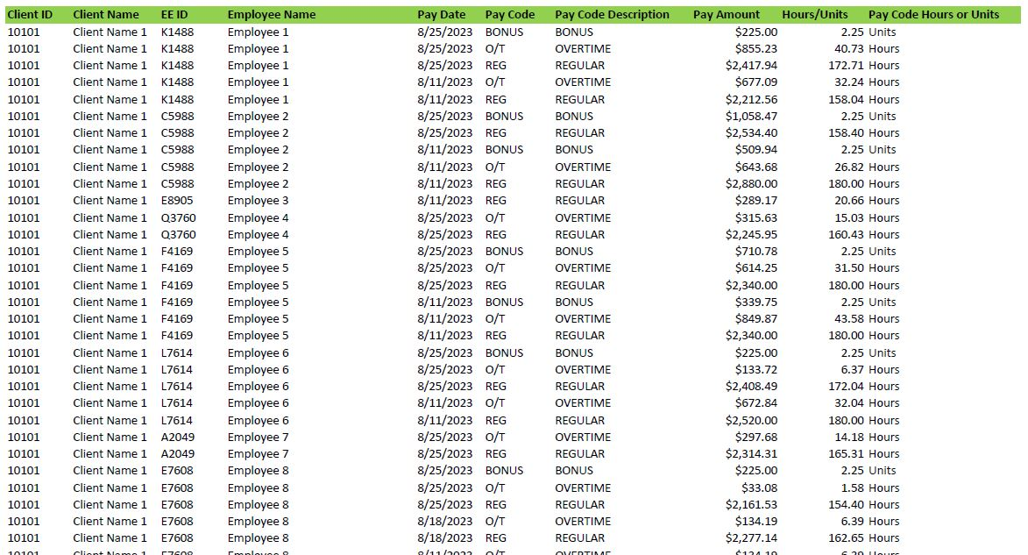
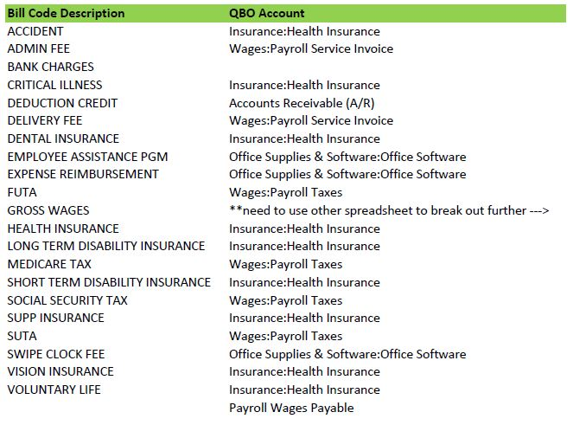
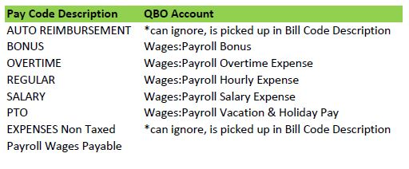
Extract: 2 payroll reports & 3 mapping tables saved in Excel
Load: Power BI
Transform: Power Query
Build final result for import
QBO Payroll Import Automation

